Slide 1
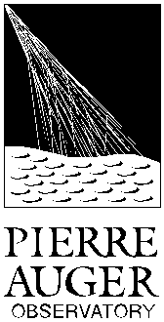

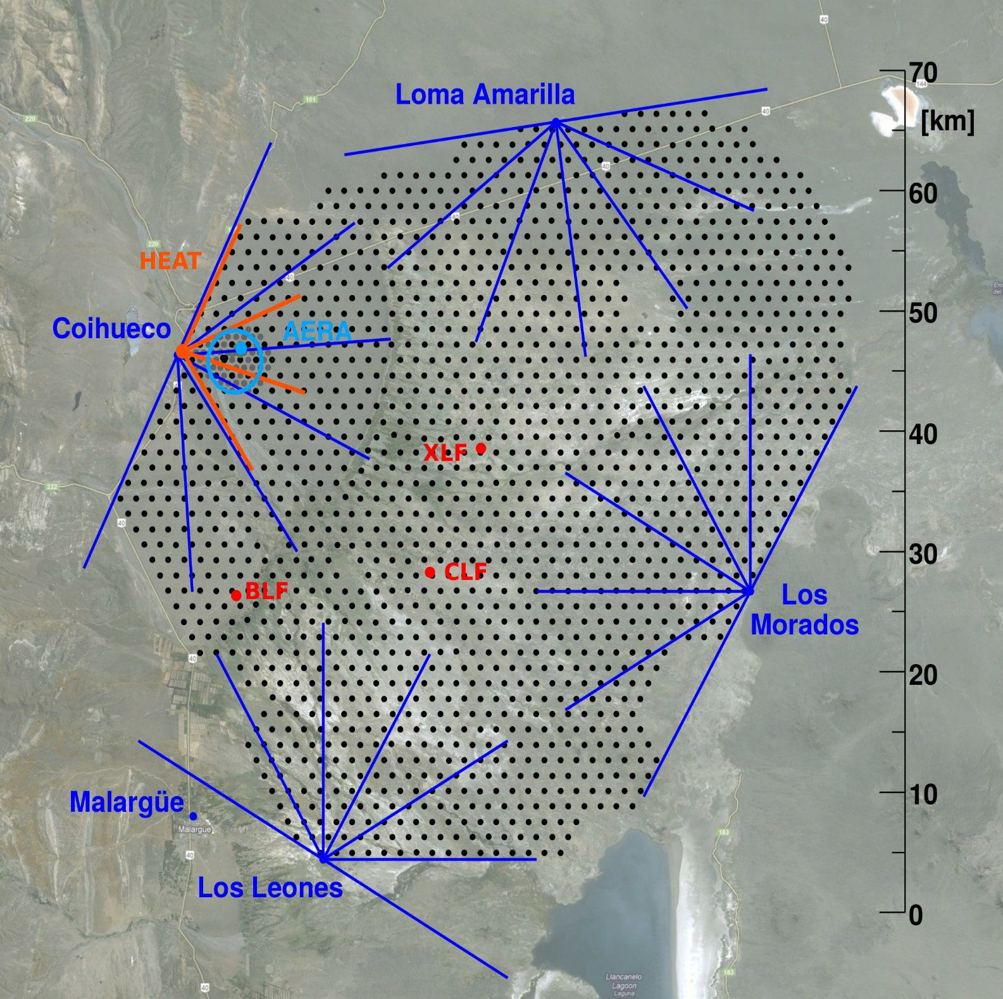
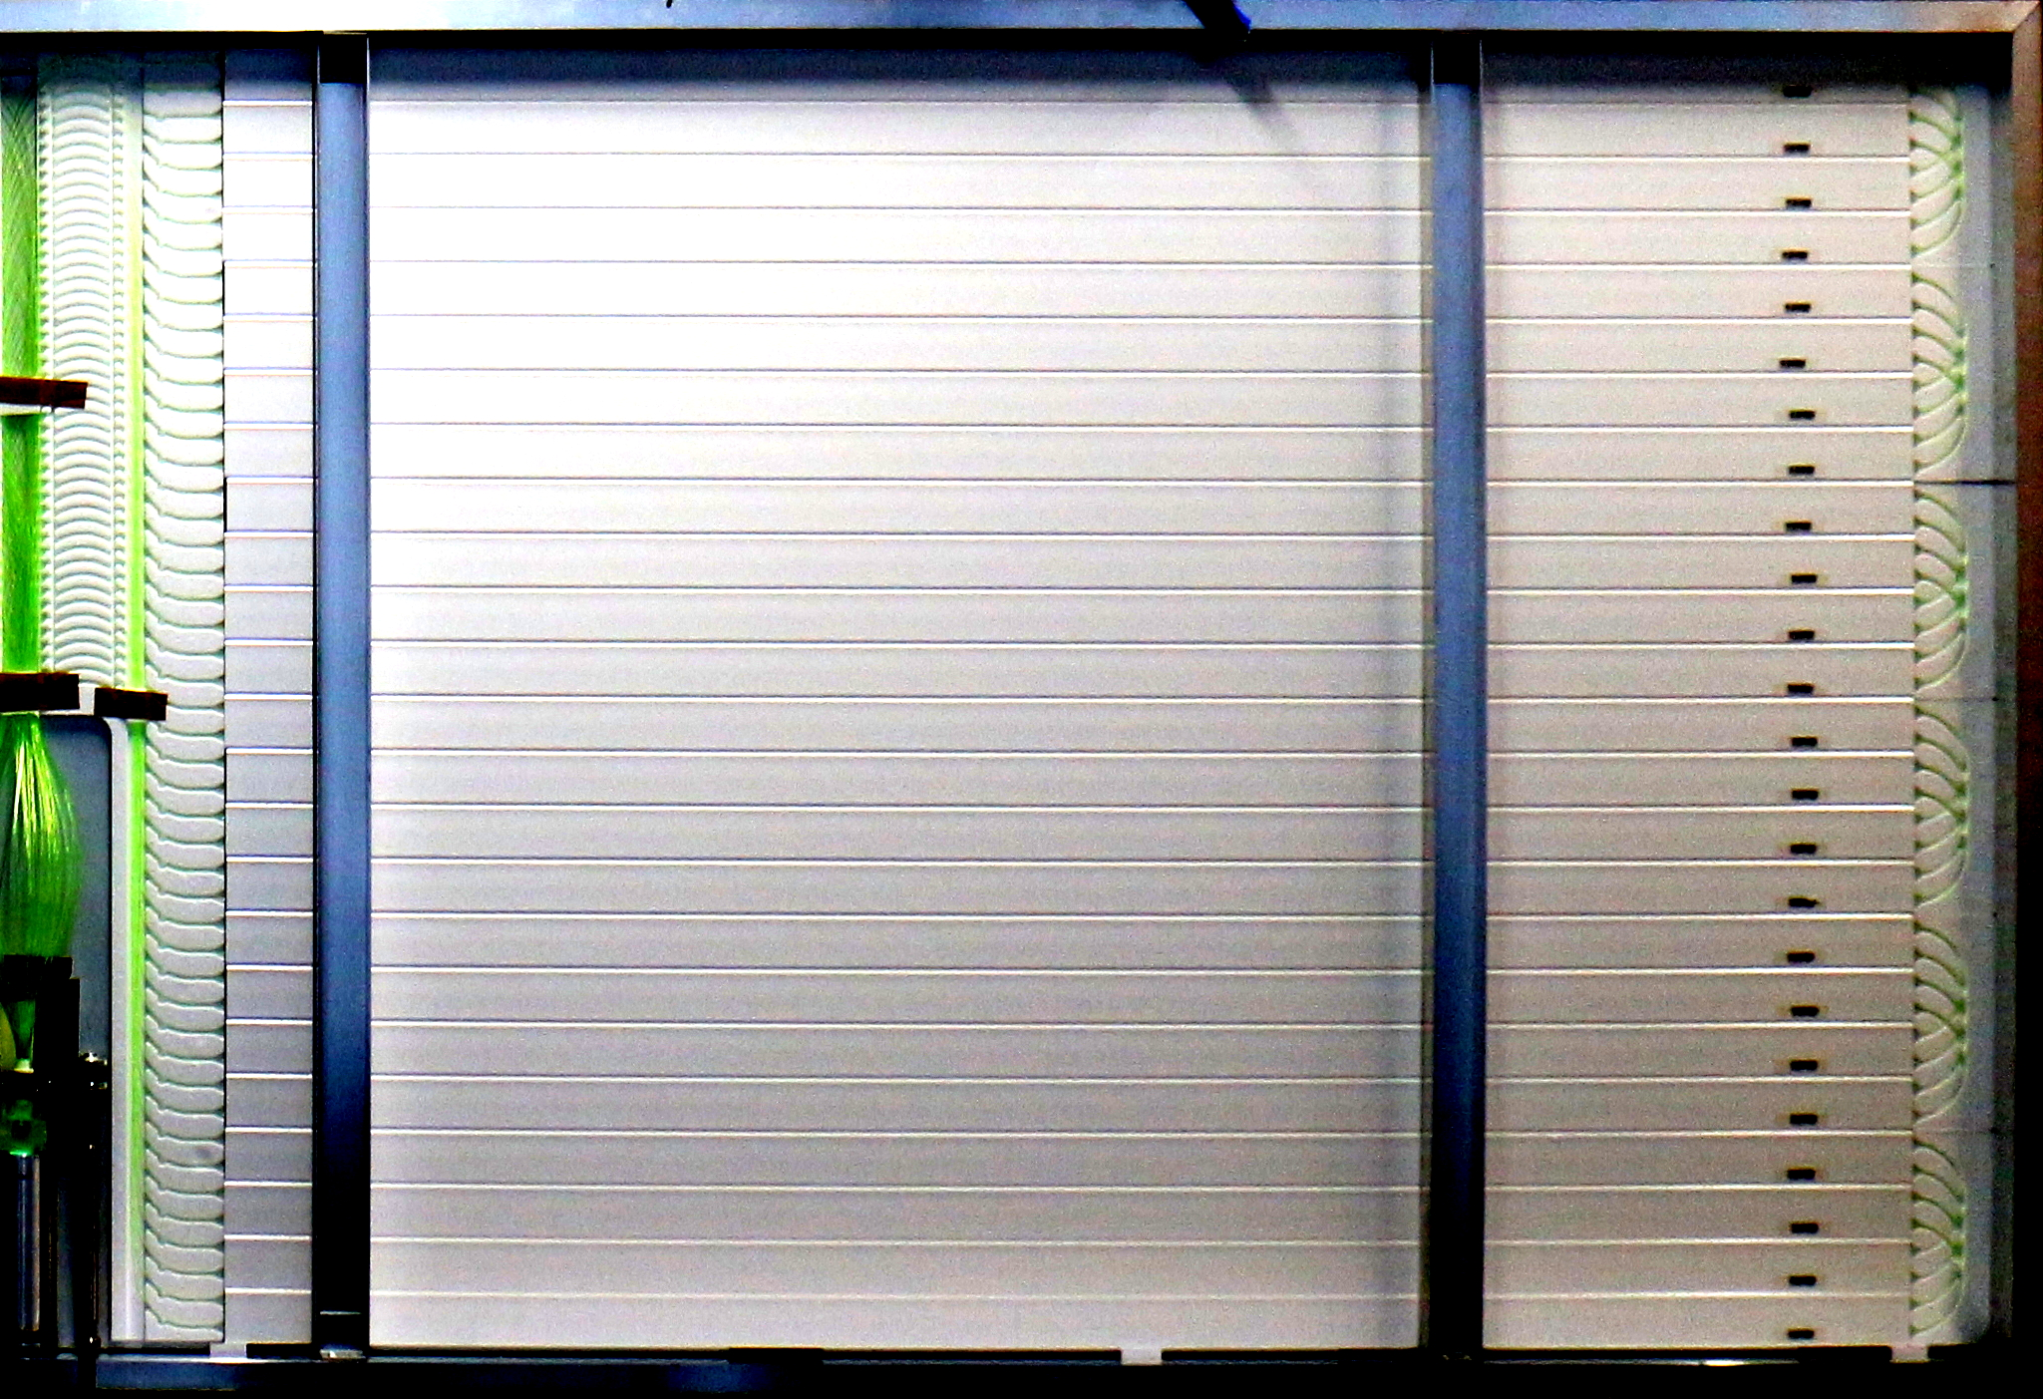
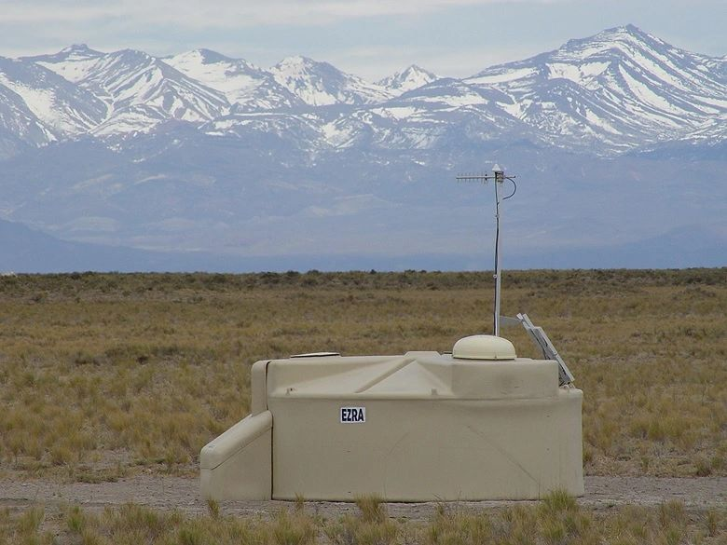
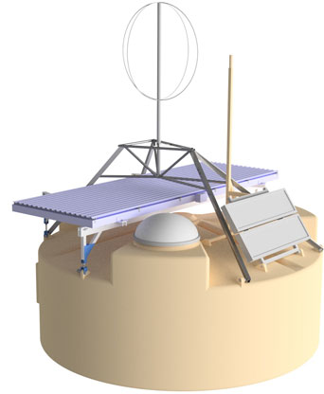
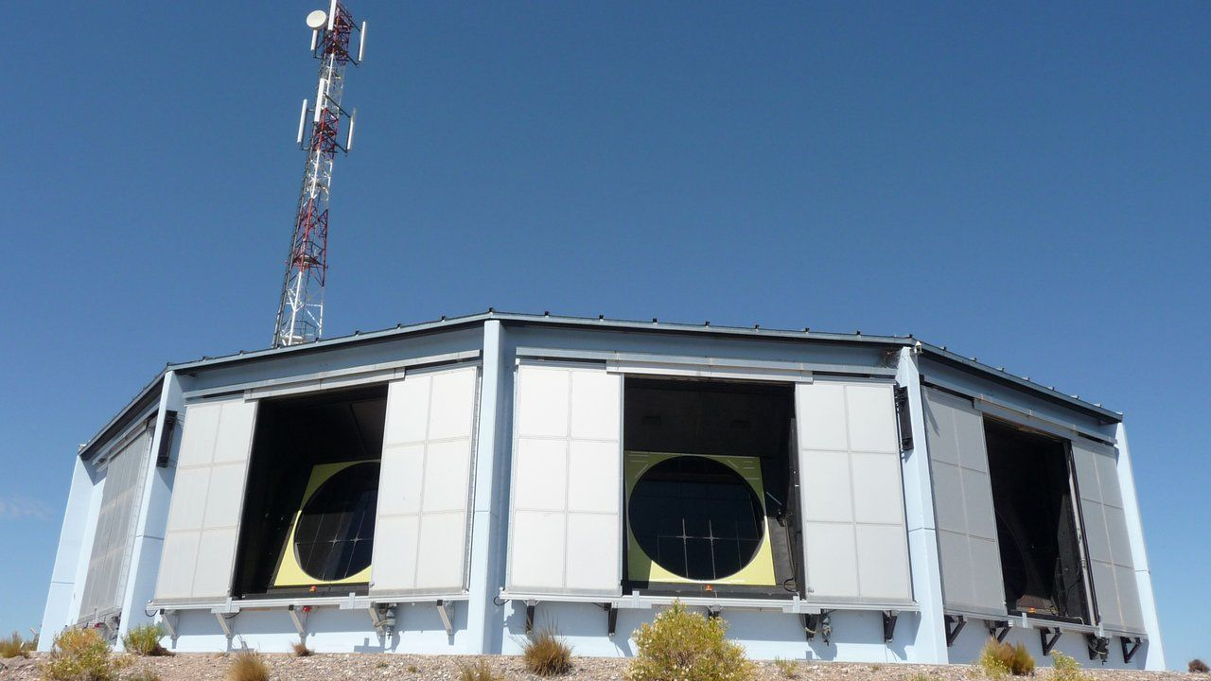
Calibration methods for the Surface Scintillator Detector of AugerPrime
a b
UHECR LOGO?
Paul Filip for the Pierre Auger Collaboration
a
b
Karlsruhe Institute of Technology, Institute for Astroparticle Physics, Germany
Observatorio Pierre Auger, Av. San Martin Norte 304, 5613 Malargue, Argentina
The Pierre Auger Observatory
AugerPrime detector upgrade
Surface Detector (SD)
~1660 surface detector stations
daily autonomous operation
Detect shower footprint on earth
Multiple detection channels
Cross-calibration via the FD
Facts & Goals
Changes in SD hardware
  New SD Electronics
  New detection channels
Better sensitivity to primary mass
See talk by D. Schmidt!
Fluorescence Detector (FD)
27 Fluorescence telescopes
Dedicated measurement shifts
Observe longitudinal shower profile
Sensitive to UV light from showers
Surface Scintillator Detector (SSD)
Mounted on top of the water tank
Extruded polystyrene scintillator bars
Sensitive to EM component of shower
Operated in slave mode to water tank
Need for calibration
Offline algorithm
(tiny) lightsource mounted on XY stage
maneuver using three stepper motors
LED/Motors controlled by Raspberry Pi
Online algorithm
Ulbricht sphere as diffuse emitter
NIST-calibrated LED (λ = 365 nm)
Portable (fits in carry-on luggage)
Calibration of source on- and off-site
Horizontal vs. Omnidirectional MIP

